Slide 1
Sports Management System
Vishal Ghorpade
Yash Sharma

Slide 2
Index
Objective
How problem solved
Working
Implementation screenshot
Conclusion

Slide 3
Sports website
Objective
The SPORTS MANAGEMENT SYSTEM objective is to provide a platform to manage the activity of many sports at a time.
The project will help the student to get register from anywhere and anytime
In this system user manage various game, tournament, schedule and team.

Slide 4
How problem solved
The idea of this project is derived from the following existing system in which student are not able to get proper information about the games conducted in various college of university .
They are only aware of the information provided by their college on day notice.

Slide 5
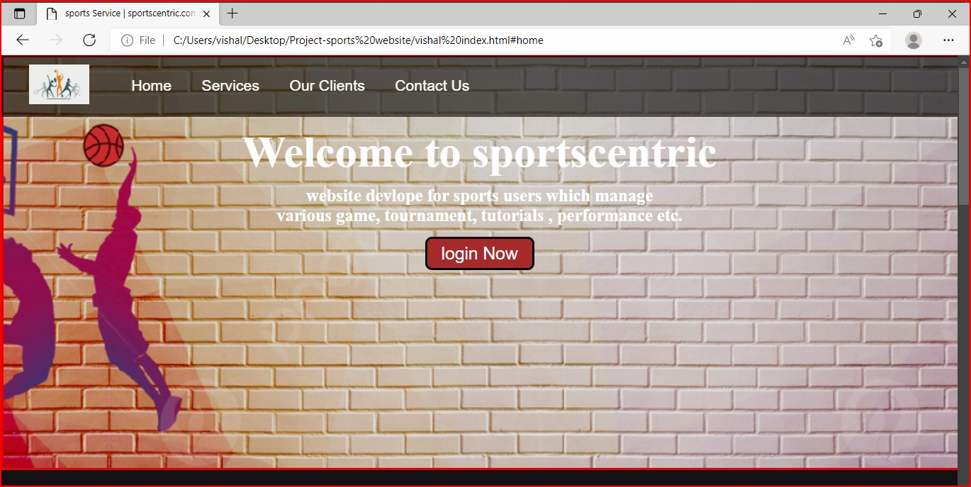
Working

Slide 6
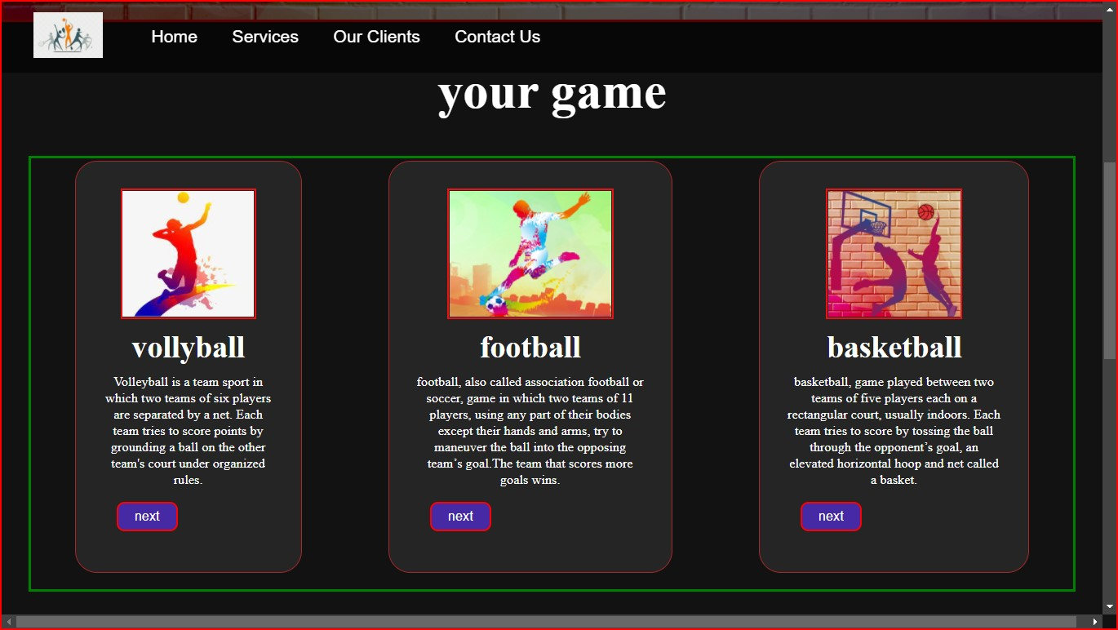

Slide 7
conclusion
helps the user /admin to quickly organize the sport event and lists in short interval of time .
it will be able to check anything related to sports at any time .
paper work and manual work is reduced through this system .
the system is user friendly and easy to use

Slide 8
Thank you

